Slide 1

OMGT1039
Operations Management
Week 3
Product/Service Design and Process Selection
New services and products are the lifeblood of a business

Slide 2
COMMONWEALTH OF AUSTRALIA
Copyright Regulations 1969
WARNING
This material has been reproduced and communicated
to you by or on behalf of Royal Melbourne Institute
of Technology, (RMIT University) pursuant to Part
VB of the Copyright Act 1968 (the Act).
The material in this communication may be subject to
copyright under the Act. Any further reproduction or
communication of this material by you may be the
subject of copyright protection under the Act.
Do not remove this notice.
First page of scanned document
This presentation includes selected slides from
William J Stevenson (2015) Operations Management, 12 ed. ISBN 10: 1259580091, McGraw Hill

Slide 3
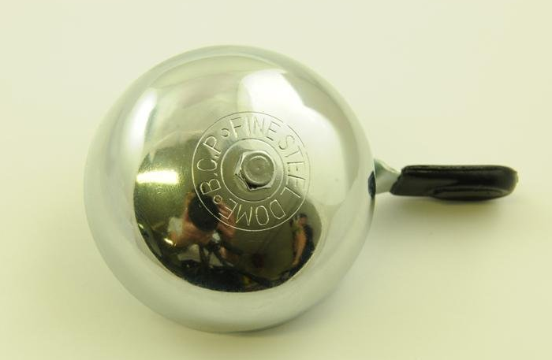
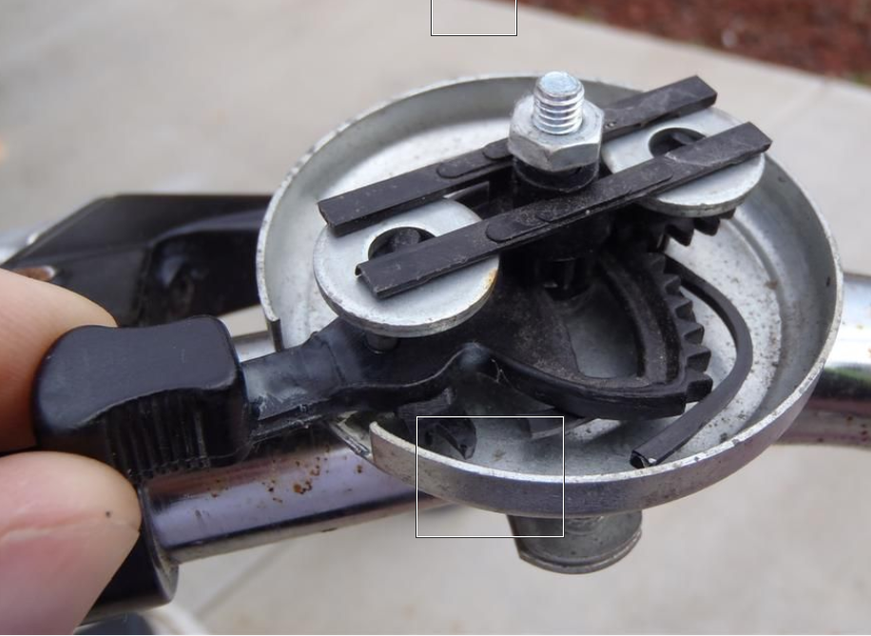
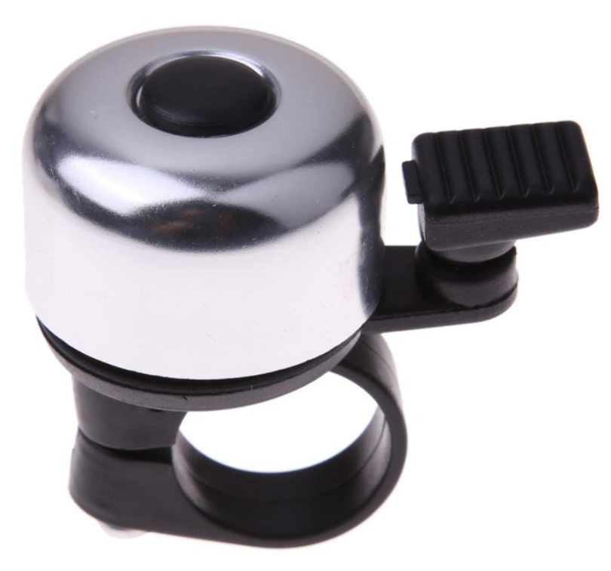

Slide 4
Learning Objectives
  Product/Service Design
  Explain the strategic importance of product and service design
  Describe what product and service design does
  Identify some reasons for design or redesign
  List some of the main sources of design ideas
  Discuss the importance of legal, ethical, and sustainability considerations in product and service design
  Explain the purpose and goal of life cycle assessment
  Explain about Quality Function Deployment and Kano model
  Process Selection
  Explain the strategic importance of process selection and the influence it has on the organization and its supply chain
  Compare the four basic processing types
  Explain the role of technology in process

Slide 5
Strategic Product and Service Design
The essence of an organization is the goods and services it offers
  Every aspect of the organization is structured around them
Product and service design – or redesign – should be closely tied to an organization’s strategy

Slide 6

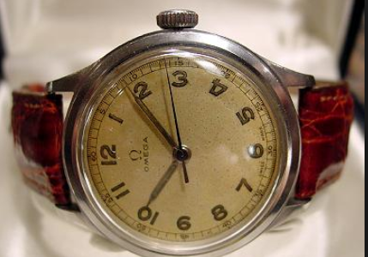
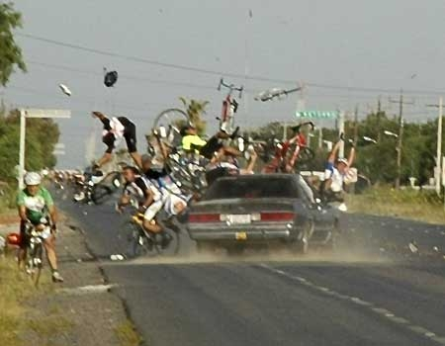
Reasons to Design or Re-Design
The driving forces for product and service design or redesign are market opportunities or threats:
  Economic
  Social and Demographic
  Political, Liability, or Legal
  Competitive
  Cost or Availability
  Technological

Slide 7
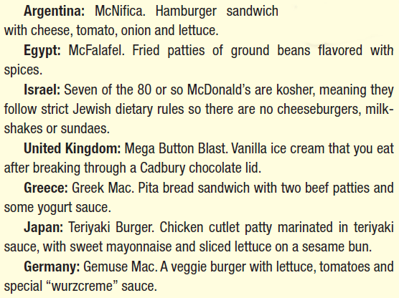
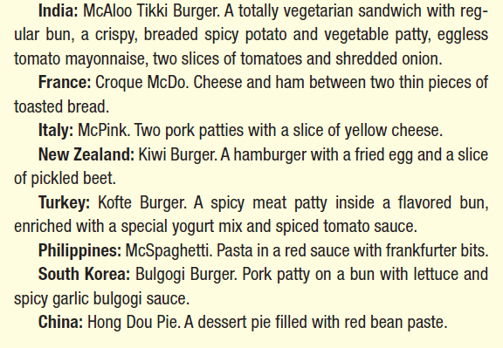
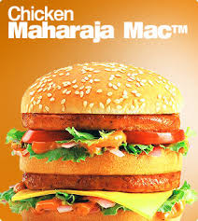
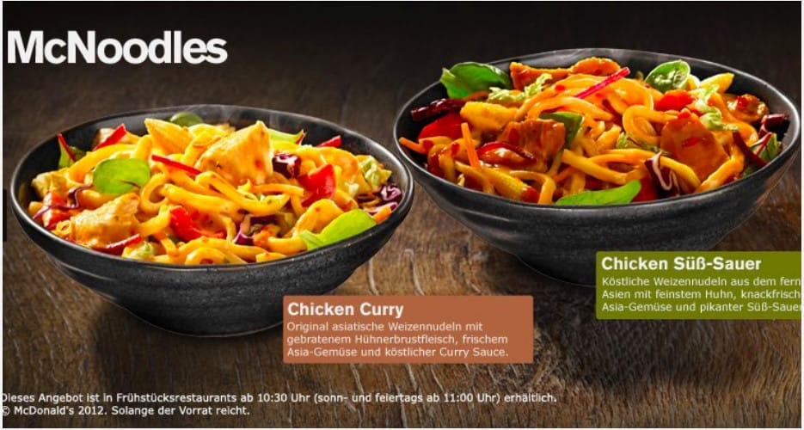
McDonald’s Menu

Slide 8
Key Questions
Is there a demand for it?
  Market size
  Demand profile
Can we do it?
  Manufacturability - the capability of an organization to produce an item at an acceptable profit
  Serviceability - the capability of an organization to provide a service at an acceptable cost or profit

Slide 9
Key Questions (contd.)
What level of quality is appropriate?
  Customer expectations
  Competitor quality
  Fit with current offering
Does it make sense from an economic standpoint?
  Liability issues, ethical considerations, sustainability issues, costs and profits

Slide 10

Idea Generation
1. Supply-chain based
2. Competitor based
3. Research based

Slide 11

Important Considerations
Legal Considerations
Ethical Considerations
Sustainability
  Key aspects of designing for sustainability
    Cradle-to-grave assessment (Life-Cycle Assessment)
    The 3-Rs
      Reduction of costs and materials used
      Re-using parts of returned products
      Recycling

Slide 12
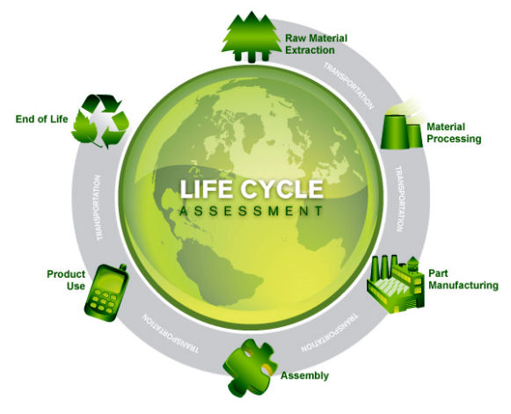
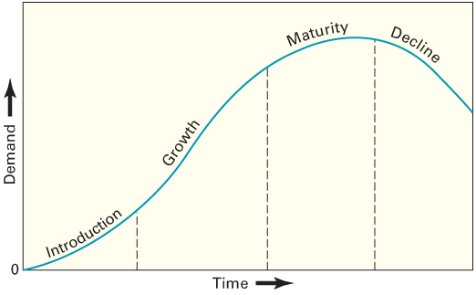
Cradle-to-Grave Assessment
Cradle-to-Grave Assessment
  aka Life-Cycle Assessment (LCA)
  The assessment of the environmental impact of a product or service throughout its useful life
    Focuses on such factors as
      Global warming
      Smog formation
      Oxygen depletion
      Solid waste generation
    LCA procedures are part of the ISO 14000 environmental management procedures
Product or service life stages

Slide 13
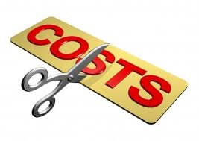
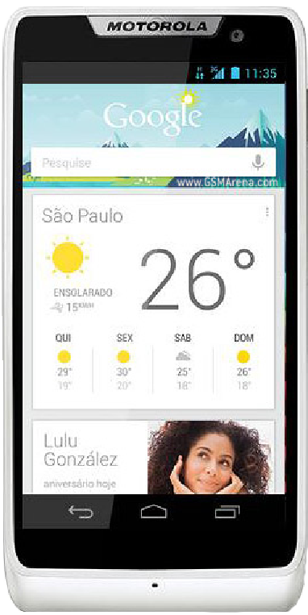
The 3-Rs:
Reduce: Costs and Materials
Value analysis
  Examination of the function of parts and materials in an effort to reduce the cost and/or improve the performance of a product
  Common questions used in value analysis
    Is the item necessary; does it have value; could it be eliminated?
    Are there alternative sources for the item?
    Could another material, part, or service be used instead?
    Can two or more parts be combined?
    Can specifications be less stringent to save time or money?
    Do suppliers/providers have suggestions for improvements?
    Can packaging be improved or made less costly?

Slide 14
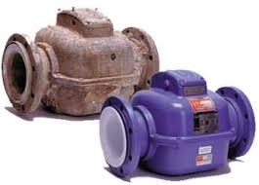
The 3-Rs:
Re-Use or Remanufacturing
Remanufacturing
  Refurbishing used products by replacing worn-out or defective components
    Can be performed by the original manufacturer or another company
  Reasons to remanufacture:
    Remanufactured products can be sold for about 50% of the cost of a new product
    The process requires mostly unskilled and semi-skilled workers
    In the global market, European lawmakers are increasingly requiring manufacturers to take back used products
  Design for disassembly (DFD)
    Designing a product to that used products can be easily taken apart

Slide 15

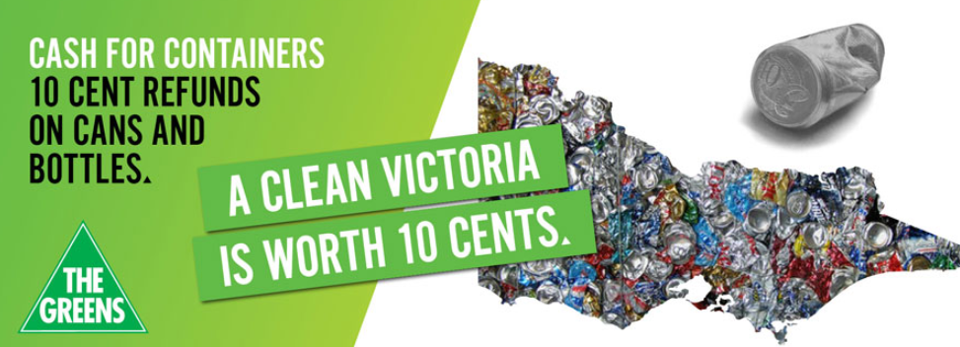
The 3-Rs:
Recycle
Recycling
  Recovering materials for future use
    Applies to manufactured parts
    Also applies to materials used during production
  Why recycle?
    Cost savings
    Environmental concerns
    Environmental regulations
  Companies doing business in the EU must show that a specified proportion of their products are recyclable

Slide 16
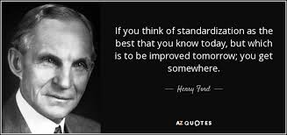
Standardization
  Extent to which there is an absence of variety in a product, service, or process
    Products are made in large quantities of identical items
    Every customer or item processed receives essentially the same service

Slide 17

Designing for
Mass Customization
Mass customization
  A strategy of producing basically standardized goods or services, but incorporating some degree of customization in the final product or service
  Facilitating Techniques
    Delayed differentiation
    Modular design
    Dell Computer: http://www.dell.com

Slide 18
Delayed Differentiation
Delayed Differentiation
  The process of producing, but not quite completing, a product or service until customer preferences are known
  It is a postponement tactic
    Produce a piece of furniture, but do not stain it; the customer chooses the stain

Slide 19
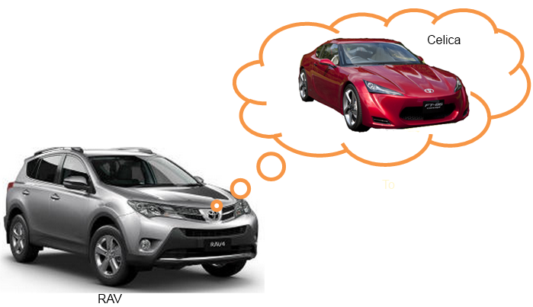
Modular Design
  A form of standardization in which component parts are grouped into modules that are easily replaced or interchanged
    Advantages
      easier diagnosis and remedy of failures
      easier repair and replacement
      simplification of manufacturing and assembly
      training costs are relatively low
    Disadvantages
      Limited number of possible product configurations
      Limited ability to repair a faulty module; the entire module must often be scrapped

Slide 20

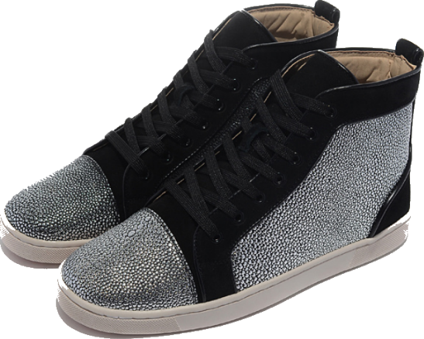
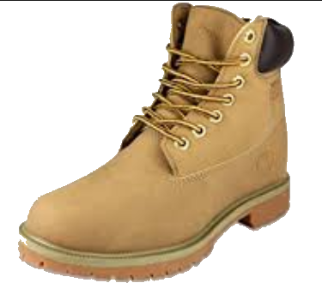
Robust Design
Robust design
  A design that results in products
  or services that can function over a
  broad range of conditions
    The more robust a product or service,
    the less likely it will fail due to a change in the environment in which it is used or in which it is performed

Slide 21
Quality Function Deployment
Quality Function Deployment (QFD)
  An approach that integrates the “voice of the customer” into both product and service development
    The purpose is to ensure that customer requirements are factored into every aspect of the process
    Listening to and understanding the customer is the central feature of QFD

Slide 22
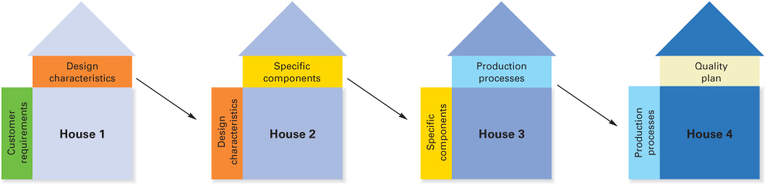
The House of Quality Sequence

Slide 23
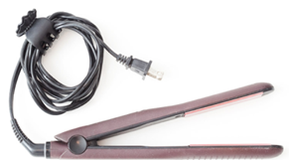
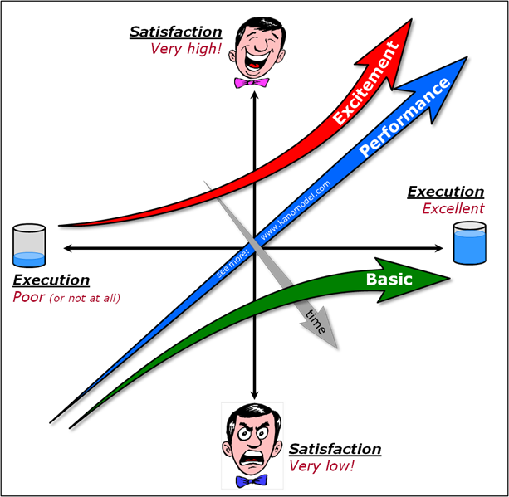
Kano Model
Basic quality
  Refers to customer requirements that have only limited effect on customer satisfaction if present, but lead to dissatisfaction if absent
Performance quality
  Refers to customer requirements that generate satisfaction or dissatisfaction in proportion to their level of functionality and appeal
Excitement quality
  Refers to a feature or attribute that was unexpected by the customer and causes excitement

Slide 24
Process Selection
Process selection
  Refers to deciding on the way production of goods or services will be organized
  It has major implications for
    Capacity planning
    Layout of facilities
    Equipment
    Design of work systems

Slide 25
Process Selection and System Design
Facilities and
Equipment
Forecasting
Capacity
Planning
Product and
Service Design
Layout
Process
Selection
Technological
Change
Work
Design

Slide 26
Process Selection
Two key questions in process selection:
How much variety will the process need to be able to handle?
How much volume will the process need to be able to handle?
Job Shop
Repetitive
Batch
Continuous
Project

Slide 27
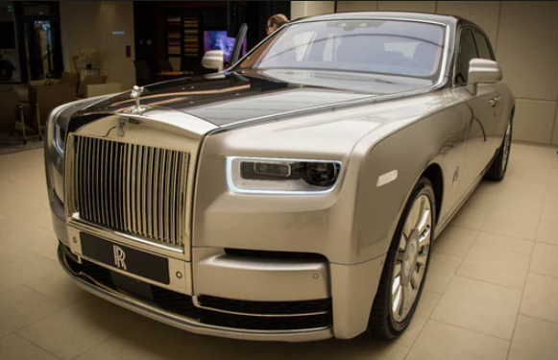
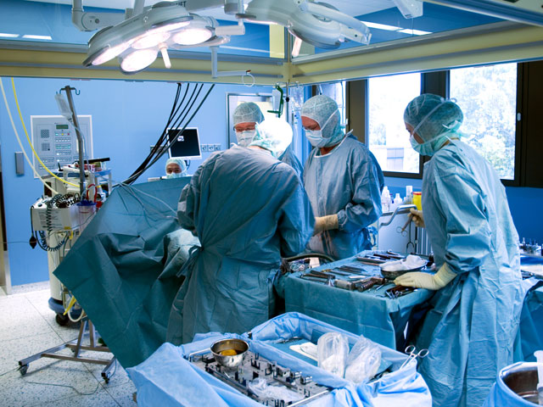
Job Shop
Intermittent work in small scale
High flexibility using general-purpose machines with high skilled workers
Manufacturing Service

Slide 28
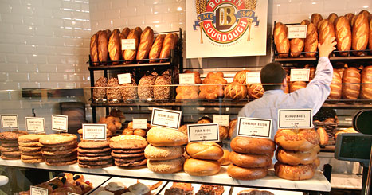

Batch
Intermittent work with moderate volume and moderate variety
Manufacturing Service

Slide 29
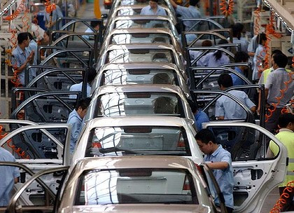
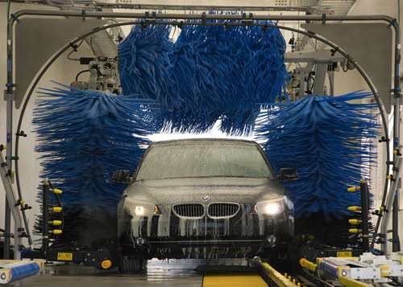
Repetitive/ Assembly
Higher volume of more standardised outputs
Manufacturing Service

Slide 30
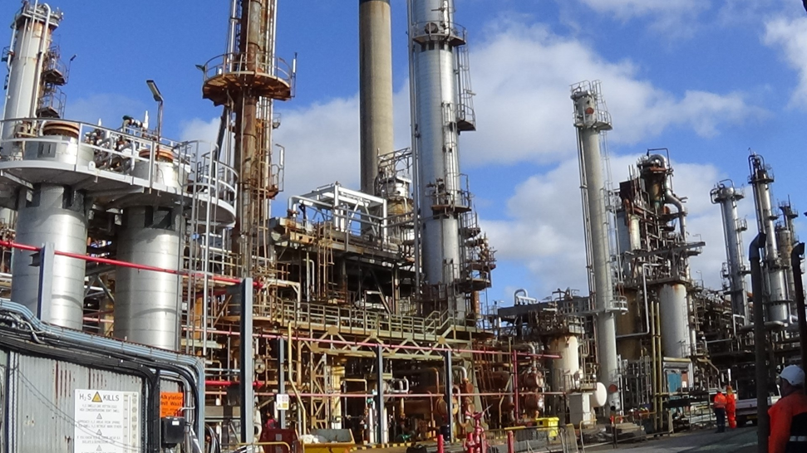

Continuous
Very high volume, highly standardised output
Very low flexibility
Usually specialised machines
Manufacturing Service

Slide 31
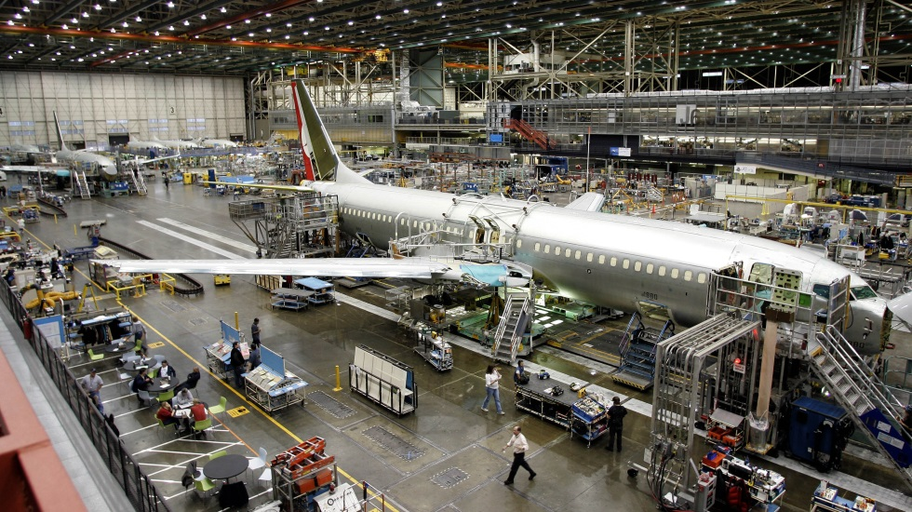

Project
Non-routine job
Limited time
Manufacturing Service

Slide 32
Types of Processing
 | Job Shop | Batch | Repetitive/ Assembly | Continuous
Description | Customized goods or services | Semi- standardized goods or services | Standardized goods or services | Highly standardized Goods or services
Advantages | Able to handle a wide variety of work | Flexibility; easy to add or change products or services | Low unit cost, high volume, efficient | Very efficient, very high volume
Disadvantages | Slow, high cost per unit, complex planning and scheduling | Moderate cost per unit, moderate scheduling complexity | Low flexibility, high cost of downtime | Very rigid, lack of variety, costly to change, very high cost of downtime

Slide 33
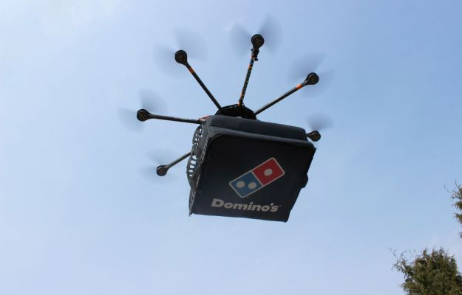
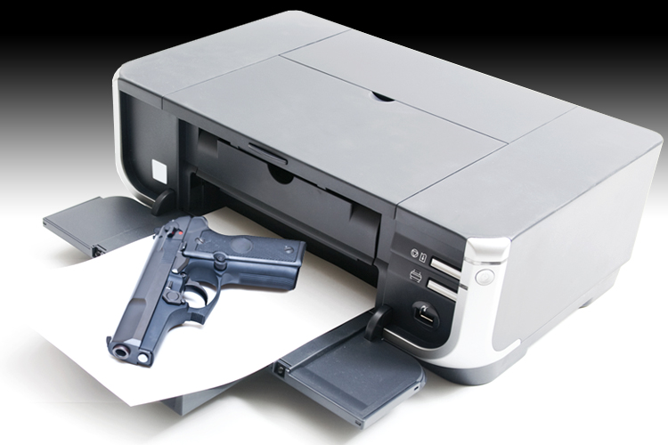
Process and Technology
    Technology: Methods, procedures, and equipment used to produce goods and provide services (3D Printing. Drone Delivery)
    Information technology: The science and use of computers and other electronic equipment to store, process, and send information (RFID)

Slide 34
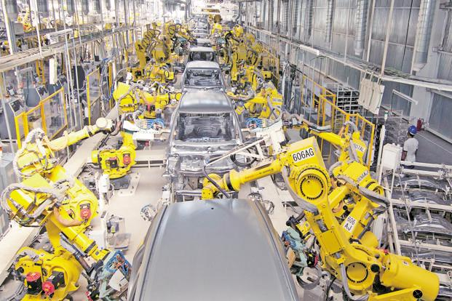
Automation
Automation
  Machinery that has sensing and control devices that enable it to operate automatically
    Fixed automation
    Programmable automation
    Flexible automation

Slide 35
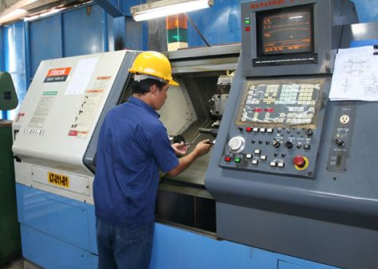
Programmable Automation
Programmable Automation
  Involves the use of high-cost, general-purpose equipment controlled by a computer program that provides both the sequence of operations and specific details about each operation
    Computer-Aided Manufacturing (CAM)
      The use of computers in process control, ranging from robots to automated quality control
    Numerically Controlled (N/C) Machines
      Machines that perform operations by following mathematical processing instructions
    Robot
      A machine consisting of a mechanical arm, a power supply, and a controller
CNC Machine

Slide 36
Flexible Automation
Flexible automation
  evolved from programmable automation. It uses equipment that is more customized than that of programmable automation. A key difference between the two is that flexible automation requires significantly less changeover time.
    FMS (Flexible Manufacturing System)
      A group of machines designed to handle intermittent processing requirements and produce a variety of similar products
    CIM (Computer Integrated Manufacturing)
      A system for linking a broad range of manufacturing activities through an integrated computer system

Slide 37
Question

